Slide 1
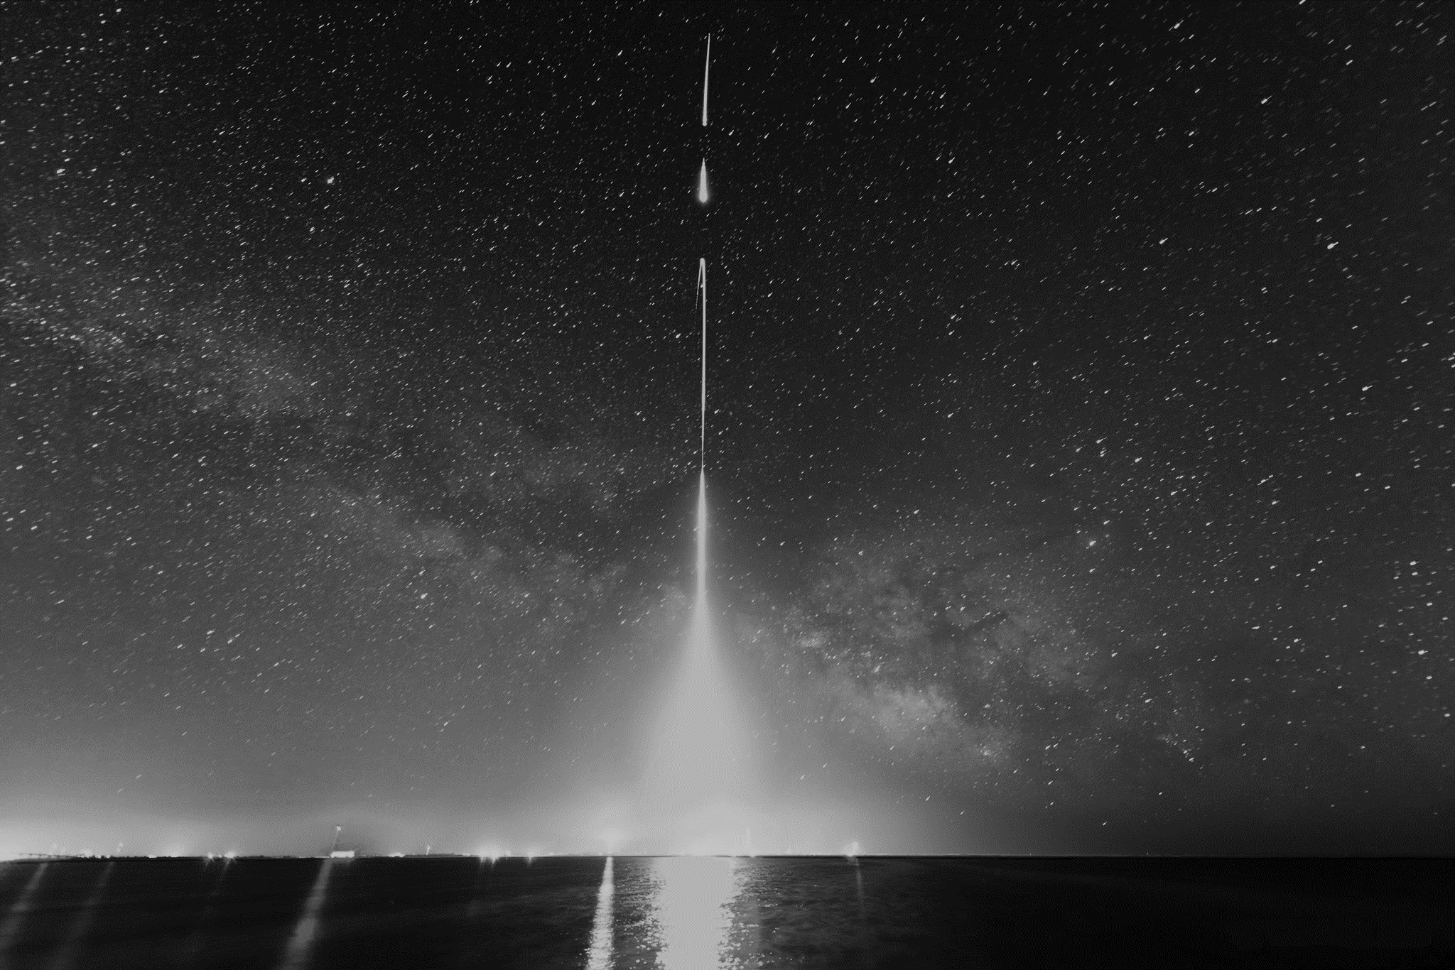
Detector Response Modeling: Dual Aperture X-ray Solar Spectrometer
APPM 4380
Final Project
Robert Sewell

Slide 2

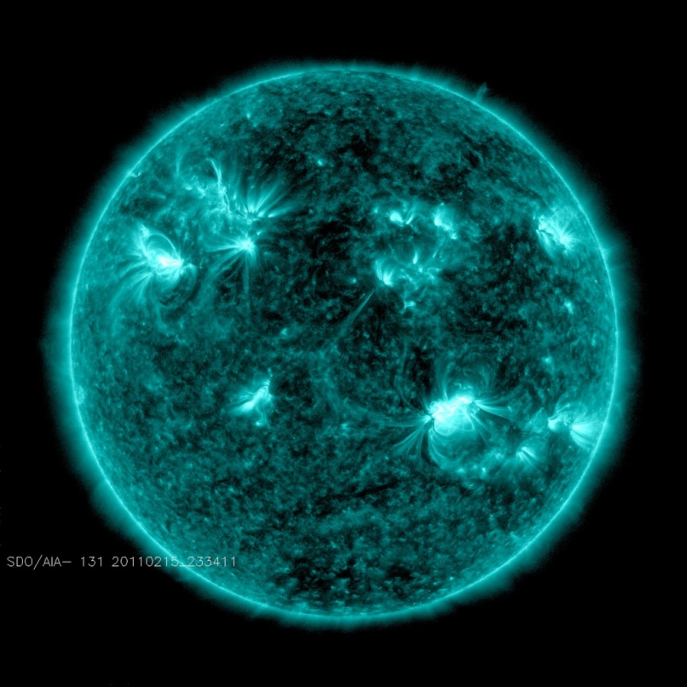
Outline
Motivation
Design
Response
Spectra

Slide 3
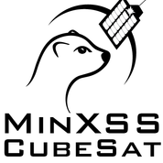
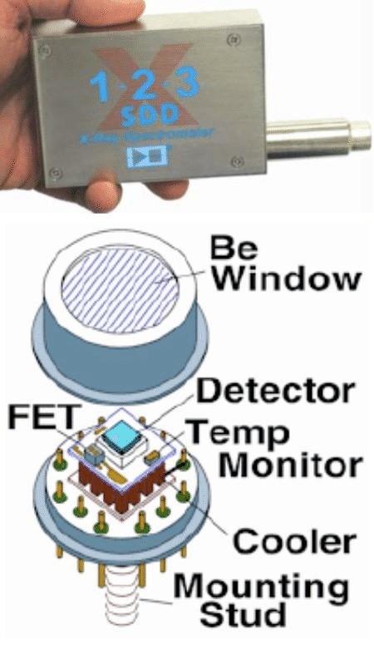
Motivation
Miniature X-ray Solar Spectrometer (MinXSS-1) CubeSat measured the soft X-ray spectra using the Amptek X123 X-ray spectrometer
0.5-30keV photon energies, gap in the solar spectra
Single beryllium aperture - reduced field of view to limit
saturation during flare events
Dual Aperture X-ray Solar Spectrometer (DAXSS) allows for
higher energy counts
Increase field of view, add a thin filter to attenuate lower
energy photons
Difficult to model response - interplay between the two
filters

Slide 4
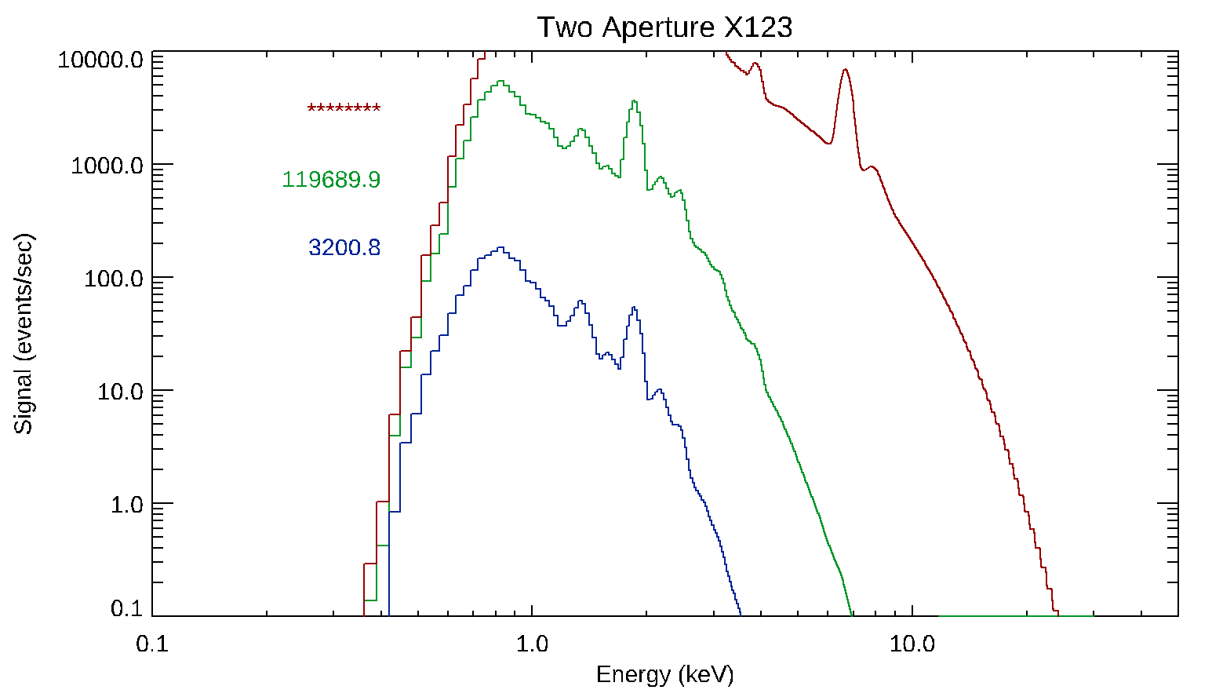
Design
Tungsten cover with aperture opening to Kapton filter with a pinhole to the exposed beryllium
Need to model possible filter materials and aperture diameters
Material should not have a k-edge
near 0.5keV-3keV – choose
carbon based material
(Kapton – C₂₂N₂O₄H₁₂)
Model detector response using
example solar flux (quiet to average
solar spectra)
Henke model of x-ray
transmission
S(E)=F_{solar}(E)T_{both}(E)
Kapton-25micron, Pinhole Diameter-0.81mm
Notes:
Kapton,mylar,lexan all nearly have same transmission profile

Slide 5
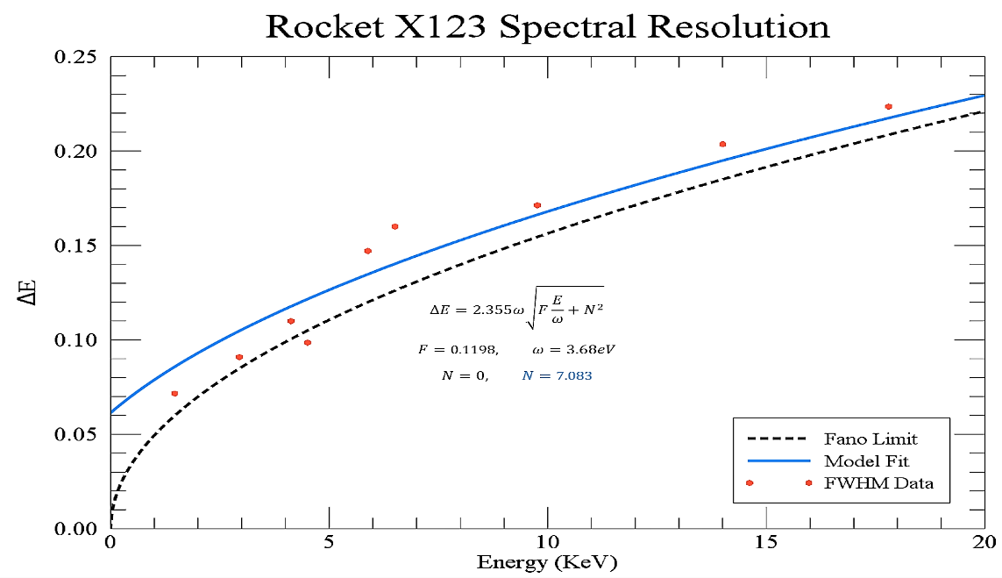
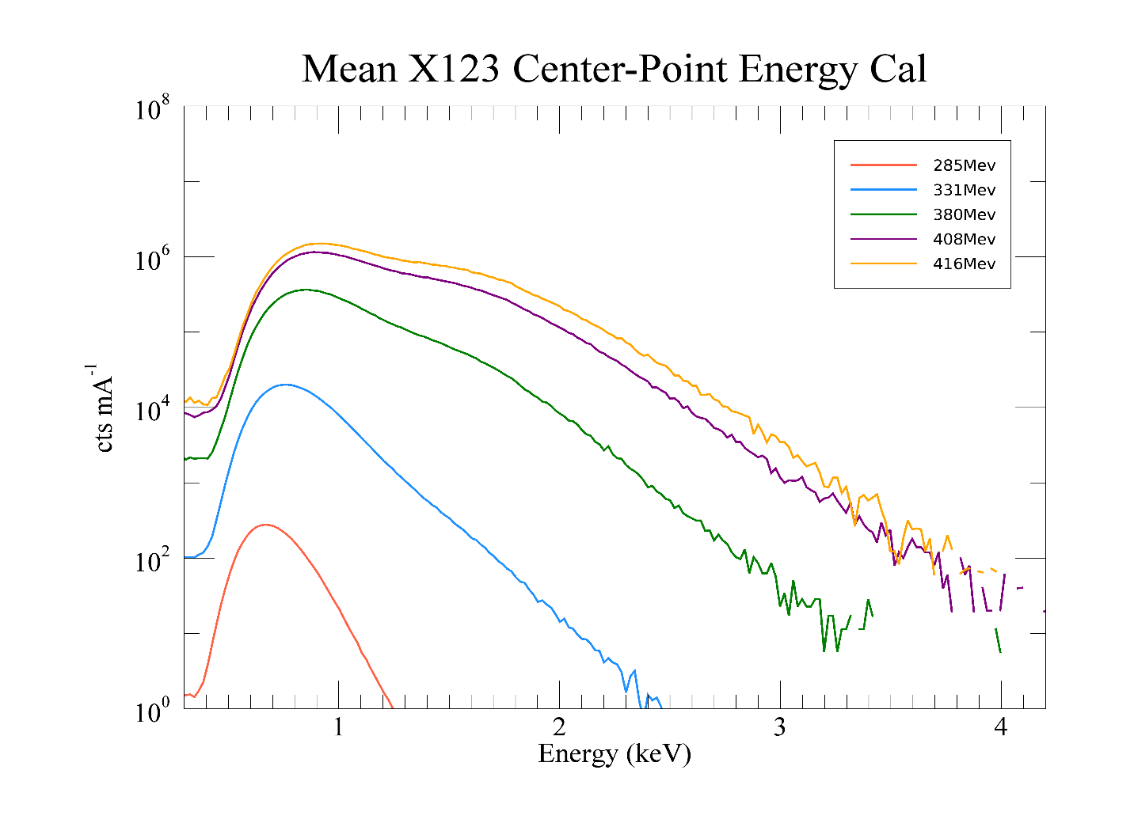
Detector Response Model
Discrete bins blend sum over continuum of photon energies – model bin width FWHM
Calibrate with known source (Synchrotron Ultraviolet Radiation Facility) to model best fit of beryllium and Kapton thicknesses
S(E)=∑[T_{BE}F_{small}+T_{both}F_{large}]*Gaussian(FWHM)*(Bin Width)
Transmission of beryllium and Kapton are variable with thicknesses

Slide 6
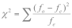
Nelder-Mead Minimization
Minimize χ² error between model response and calibration response
Use nelder-mead method with a simplex in Kapton-beryllium thickness space
Iterate with different simplexes to verify global minima

Slide 7
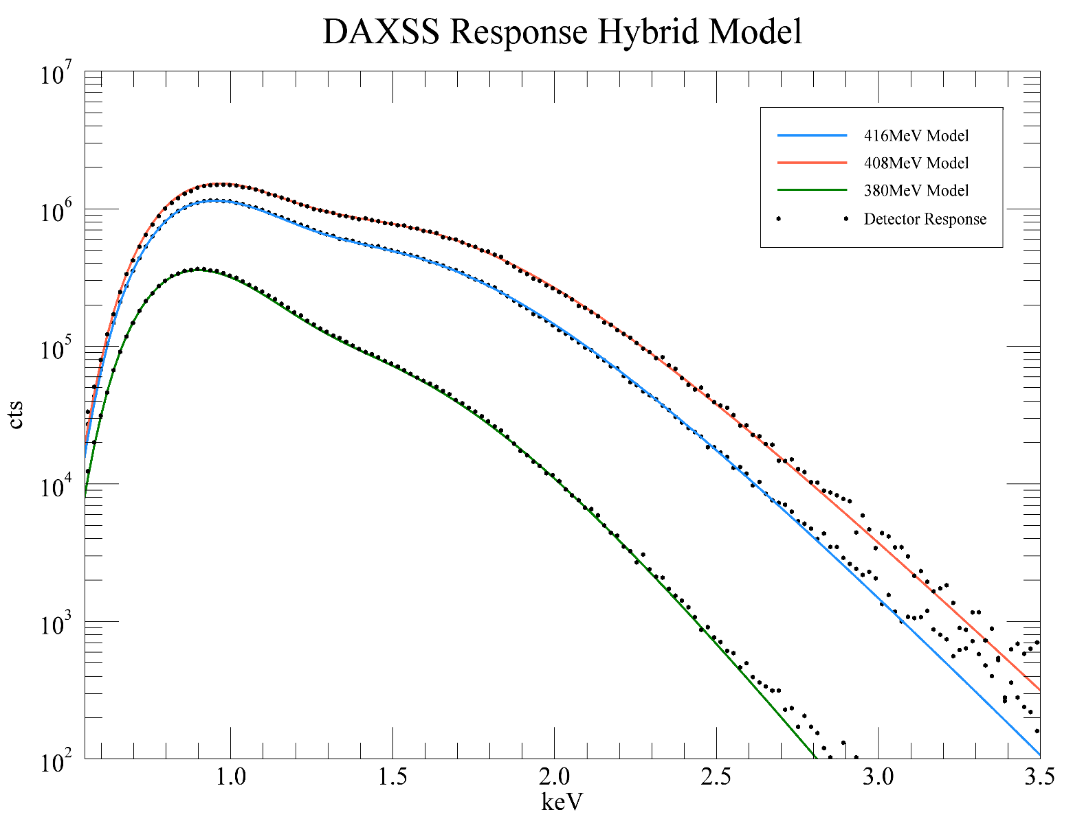
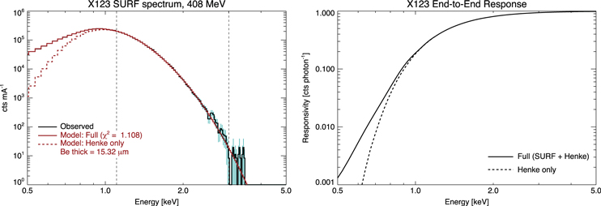
Hybrid Model – Full Spectra
Henke transmission model works well for E_{photon}>1keV to provide a continuum
Photon-electron effects prevalent <1keV
Direct inversion at middle beam energy as an approximation

Slide 8
Launch
DAXSS launched on NASA Sounding rocket 36.336
Calibration mission for SDO EVE
Secondary payload (12 instruments total)
White Sands Missile Range, New Mexico –
2018-06-18 19:00:00 UTC

Slide 9
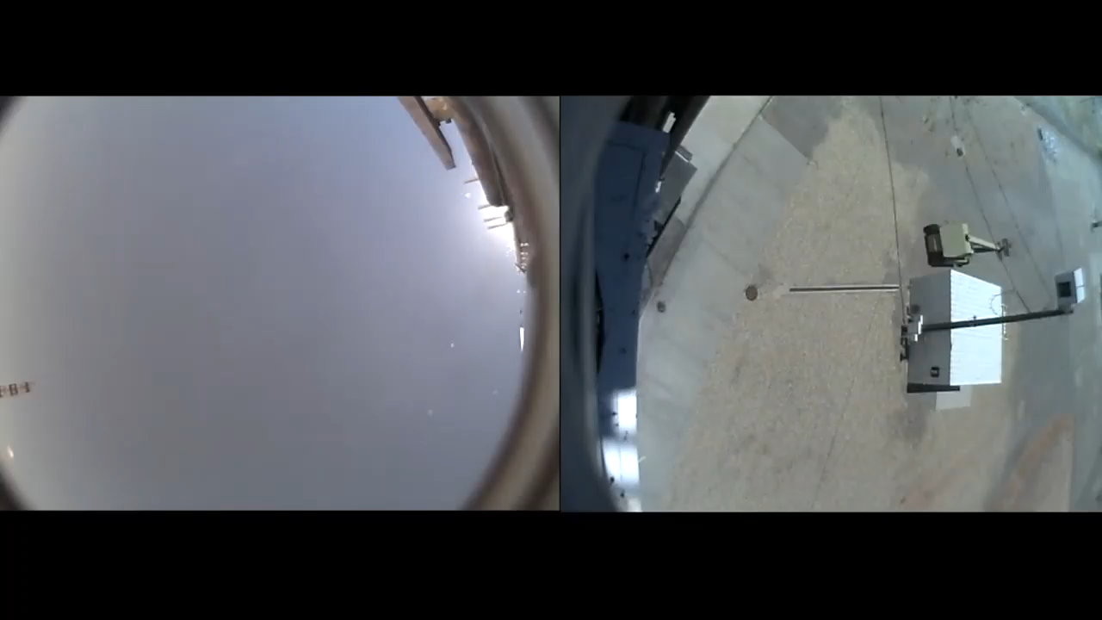
Launch

Slide 10
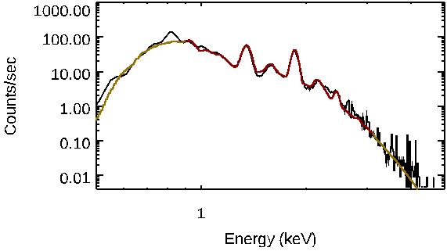
Spectral Fitting
CHIANTI spectra modeling to fit rocket flight data using detector response matrix model
Several tunable parameters (two temperature fits, elemental abundances)
Minimize χ² with similar method in n-dimension parameter space
Need to implement Nelder-Mead or similar minimization algorithm as binary search is computationally expensive

Slide 11
Future Directions
Photo-electron effects
Nelder-mead for spectral fitting
Feasibility for CubeSat mission

Slide 12
Works Cited
Bradt, Hale. Astronomy Methods: a Physical Approach to Astronomical Observations. Cambridge University Press, 2009.
Caspi, Amir, et al. “New Observations Of The Solar 0.5–5 Kev Soft X-Ray Spectrum.” The Astrophysical Journal, vol. 802, no. 1, 2015, doi:10.1088/2041-8205/802/1/l2.
Joglekar, Sachin. “Nelder-Mead Optimization.” Sachin Joglekar's Blog, 16 Jan. 2016, codesachin.wordpress.com/2016/01/16/nelder-mead-optimization/.
http://jsoc.stanford.edu/images/fixed/AIA_131.jpg

